Slide 1
IT6008: Computer Programming 1
Unit 5 – Repetition

Slide 2
IT6008: Computer Programming 1
5A - Loops

Slide 3
Assumed knowledge
Before the beginning of this lecture, students should be familiar with:
Variables and constants
Assignment statements
Writing expressions
Evaluating boolean expressions
Before the beginning of this lecture, students should have read over:
Chapter 4 pages 132-143 &147-156 of Lewis et al.

Slide 4
Objectives
By the end of this lecture, students should:
Understand repetition (looping) control structures
Understand the difference between a for loop, a while loop and a do…while loop
Be able to construct and use loops of each of these types
Understand how to form and use nested control structures

Slide 5
Repetition
Repeat an instruction...
… for as long as some condition holds
Test the condition once each iteration
Also known as iteration or loop

Slide 6
Repetition Example - using flowchart
Problem: Create a flowchart that will simulate how an ATM machine works. You can use the following steps.
User inserts ATM card and enters pin number.
If the pin number entered is valid, then screen is displayed to user where he/she can choose to withdraw money.
Otherwise, maybe pin number is incorrect, therefore user cannot withdraw money.
If user enters incorrect pin more than 3 times, card is swallowed by ATM machine.
Think of other decisions made during an ATM transaction?
Discuss the ATM machine Soln.

Slide 7
ATM Example – program flow (with loops)
User enters pin number
User inserts card
Loop 1
Is pin correct?
Condition 1
Yes
No
Message to user: enter amount to withdraw
Message to user : You have entered an incorrect pin
Is amount < balance?
Loop 2
Condition 2
Yes
No
Amount is issued
Message to user : insufficient funds

Slide 8
Repetition in Java
Repetition statements are controlled by boolean expressions (like conditional statements)
Java has three kinds of repetition statements:
the while loop
the do… while loop
the for loop
The programmer should choose the right kind of loop for the situation

Slide 9
The while loop
If the condition is true, the block is executed
Then the condition is evaluated again, and if it is still true, the block is executed again
The block is executed repeatedly until the condition becomes false
The condition is evaluated at the start of each iteration.
When the condition evaluates to false, the block is not executed. Control passes to the next statement after the block.
Syntax
while ( condition )
block

Slide 10
Logic of a while loop
condition
evaluated
true
false
block

Slide 11
An example of a while loop
If the condition of a while loop is false initially, the statement is never executed
Therefore, the body of a while loop will execute zero or more times
int count = 1;
while (count <= 5)
{
System.out.println (count);
count++;
}

Slide 12
Infinite Loops
The body of a while loop eventually must make the condition false
If not, it is called an infinite loop, which will execute until the user interrupts the program
This is a common logical error
You should always double check the logic of a program to ensure that your loops will terminate normally

Slide 13
Example of an Infinite Loop
This loop will continue executing until interrupted (Control-C) or until an underflow error occurs
int count = 1;
while (count <= 25)
{
System.out.println (count);
count = count - 1;
}

Slide 14
The do… while loop
A do… while loop has the following syntax:
do
block
while ( condition );
The block is executed once initially, and then the condition is evaluated
The statement is executed repeatedly until the condition becomes false
The condition is evaluated at the end of each iteration
When the condition becomes false, control passes to whatever comes next.
note semi-colon at end of the loop

Slide 15
Logic of a do…while loop
block
true
condition
evaluated
false

Slide 16
The do…while loop
An example of a do…while loop
int count = 1;
do
{
System.out.println (count);
count++;
}
while (count <= 5);
Note the semi-colon here
In a do…while loop the statement is first executed and then the condition is evaluated
Therefore, the body of a do..while loop will execute at least once

Slide 17
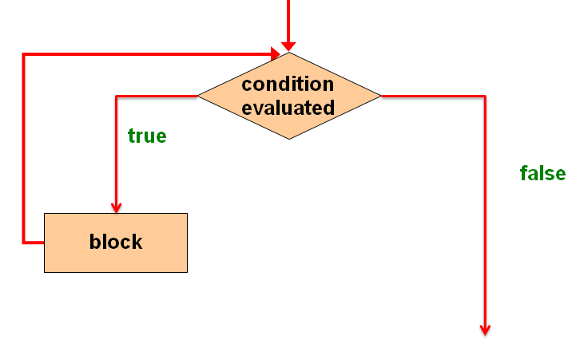
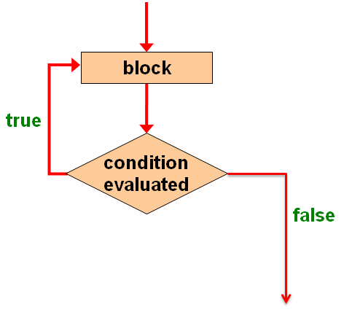
Comparing while and do … while
The while loop
The do… while loop
“test condition then execute block”
“execute block then test condition ”

Slide 18
Time Out Questions – Common Mistakes
What is wrong here?
while (num < minimum);
{
num = console.nextInt();
System.out.println(“Number must be greater than “ + minimum);
System.out.println(“Please try again.”);
}
Notes:
Semi-Colon at the end of the while statement is the problem

Slide 19
The for loop
A for loop has the following syntax
The initialization
is executed once
before the loop begins
The block is
executed until the
condition becomes false
for ( initialization ; condition ; increment )
{
statements
}
The increment portion is executed at the end of each iteration

Slide 20
Logic of a for loop
initialization
condition
evaluated
true
false
statements
increment

Slide 21
Example of for loop
An example of a for loop
for (int count=1; count <= 5; count++)
{System.out.println (count);}
The initialization section can be used to declare a variable
Like a while loop, the condition of a for loop is tested prior to executing the loop body
Therefore, the body of a for loop will execute zero or more times

Slide 22
The for loop increment
The increment section can perform any calculation
for (int num=100; num > 0; num -= 5)
{System.out.println (num);}
A for loop is well suited for executing statements a specific number of times that can be calculated or determined in advance

Slide 23
The for loop equivalency
A for loop is functionally equivalent to the following while loop structure
initialization;
while ( condition )
{
statements;
increment;
}
for ( initialization ; condition ; increment )
{
statements
}

Slide 24
while and for loop equivalence
while loop for loop
int count=0;
int sum=0;
while (count < max)
{
int newInt = scan.nextInt();
sum = sum + newInt;
count++;
}
int sum=0;
for (int count=0; count < max; count++)
{
int newInt =scan.nextInt();
sum = sum + newInt;
}
Every for loop can always be rewritten as a while loop
for loops are typically preferred for any form of “counting”
(i.e., where the number of iterations is known)

Slide 25
The for loop header
Each expression in the header of a for loop is optional
If the initialization is left out, no initialization is performed
If the condition is left out, it is always considered to be true, and therefore creates an infinite loop
If the increment is left out, no increment operation is performed

Slide 26
Local loop variables
You can declare a new counter variable locally for the loop body. This is done in the for initalization (good style!)
int count;
int sum=0;
for (count=0; count < max; count++)
{
int newInt = scan.nextInt();
sum = sum + newInt;
}
int sum=0;
for (int count=0; count < max; count++)
{
int newInt = scan.nextInt();
sum = sum + newInt;
}

Slide 27
IT6008: Computer Programming 1
5B - Validation using loops, nested loops

Slide 28
Using a boolean variable to control a loop
Good practice to make
this a constant
int guess;
final int SENTINEL = 5;
boolean exit=false;
do
{
System.out.println(“Enter a number”;
guess=console.nextInt( );
if (guess == SENTINEL)
{
exit=true;
}
} while (!exit);
Use boolean variable to
control the loop
If this statement is executed
the loop ends
If the boolean is false the
loop repeats
Advantage: using a boolean to control a loop is a standard approach which can be applied to very many looping situations

Slide 29
Validation: using a loop
Users do not always enter values in the expected range. To prevent
our programs from performing abnormally due to unexpected
user input, it is important to use validation. We have previously
used IF-statements to validate user input. Another useful way of
doing this is to use looping; this allows an instruction which was
not followed correctly to be repeated before continuing with the
program. The invalid input is prevented.
Notes:
Yep! The Same

Slide 30
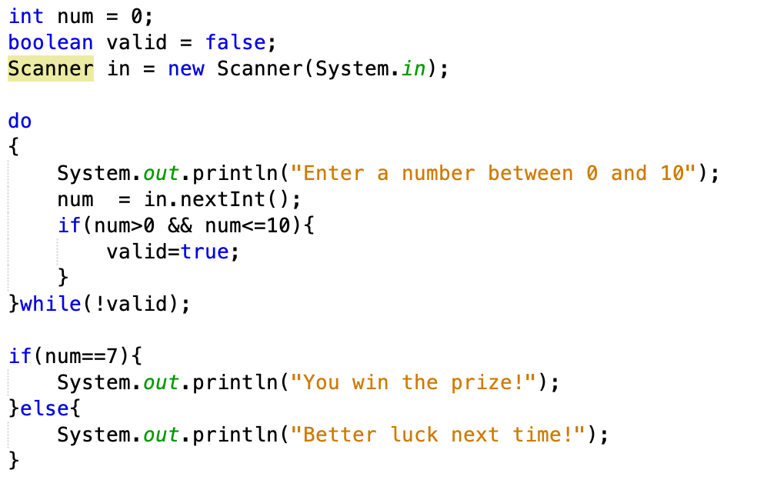
Validation: using a loop
Declaration of data
Validation loop
Action on data
Notes:
Yep! The Same

Slide 31
Nested Loops
In some cases the specifications of a problem solution may
require using another inner loop ‘nested’ inside another
loop.
Example:
The ATM problem we solved using Nested IF-logic in Unit 4 could also be approached by using nested loops.
The instruction to enter a PIN is repeated until correct (outer
loop), and then the instruction to enter an amount is repeated
until the amount is less than the balance (inner loop). The inner
loop is reached only if the condition of the outer loop changes.
Notes:
Yep! The Same

Slide 32
ATM Example – program flow (nested loops)
User enters pin number
User inserts card
Loop 1
Outer Loop
Is pin correct?
Condition 1
Yes
No
Message to user: enter amount to withdraw
Message to user : You have entered an incorrect pin
Is amount < balance?
Loop 2
Condition 2
Inner Loop
Yes
No
Amount is issued
Message to user : insufficient funds

Slide 33
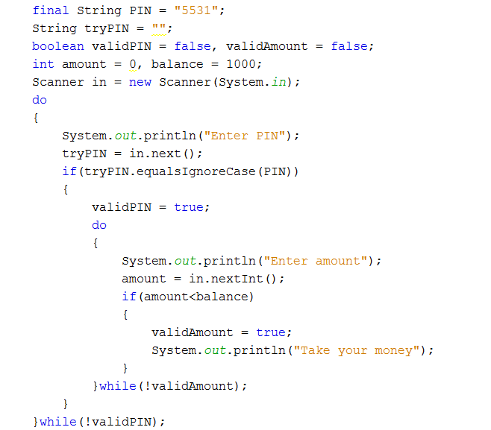
Nested Loops
Outer loop:
enter a PIN is repeated until correct
Inner loop: enter an amount is repeated
until the amount is less than the balance
Notes:
Yep! The Same

Slide 34
Picking the right loop
If the number of repetitions can be determined prior to entering the loop – use a for loop
If the number of repetitions cannot be determined prior to entering the loop and you wish to allow for the possibilities of zero repetitions use a while loop
If the number of repetitions cannot be determined prior to entering the loop, but you do know that it will always be executed at least once, use a do …while loop

Slide 35
Ask yourself …
Do you understand when you might need to use a loop?
Can you convert a for loop into a while loop?
Could you implement a while loop, a for loop and a do … while loop?
Could you explain the different between a while loop and a do .. while loop?
Can you write a JAVA program that requires a nested loop?

